Slide 1
INTERNSHIP (2023)
Nishant Tandon
300102221087

Slide 2

Internship Site
OctaNet Software Services
Founded in 2020 is a IT service company.
Their main activites:
Providing Internships Programs
E-Commerce websites
Cloud Hosting Platform
Mobile Applications

Slide 3
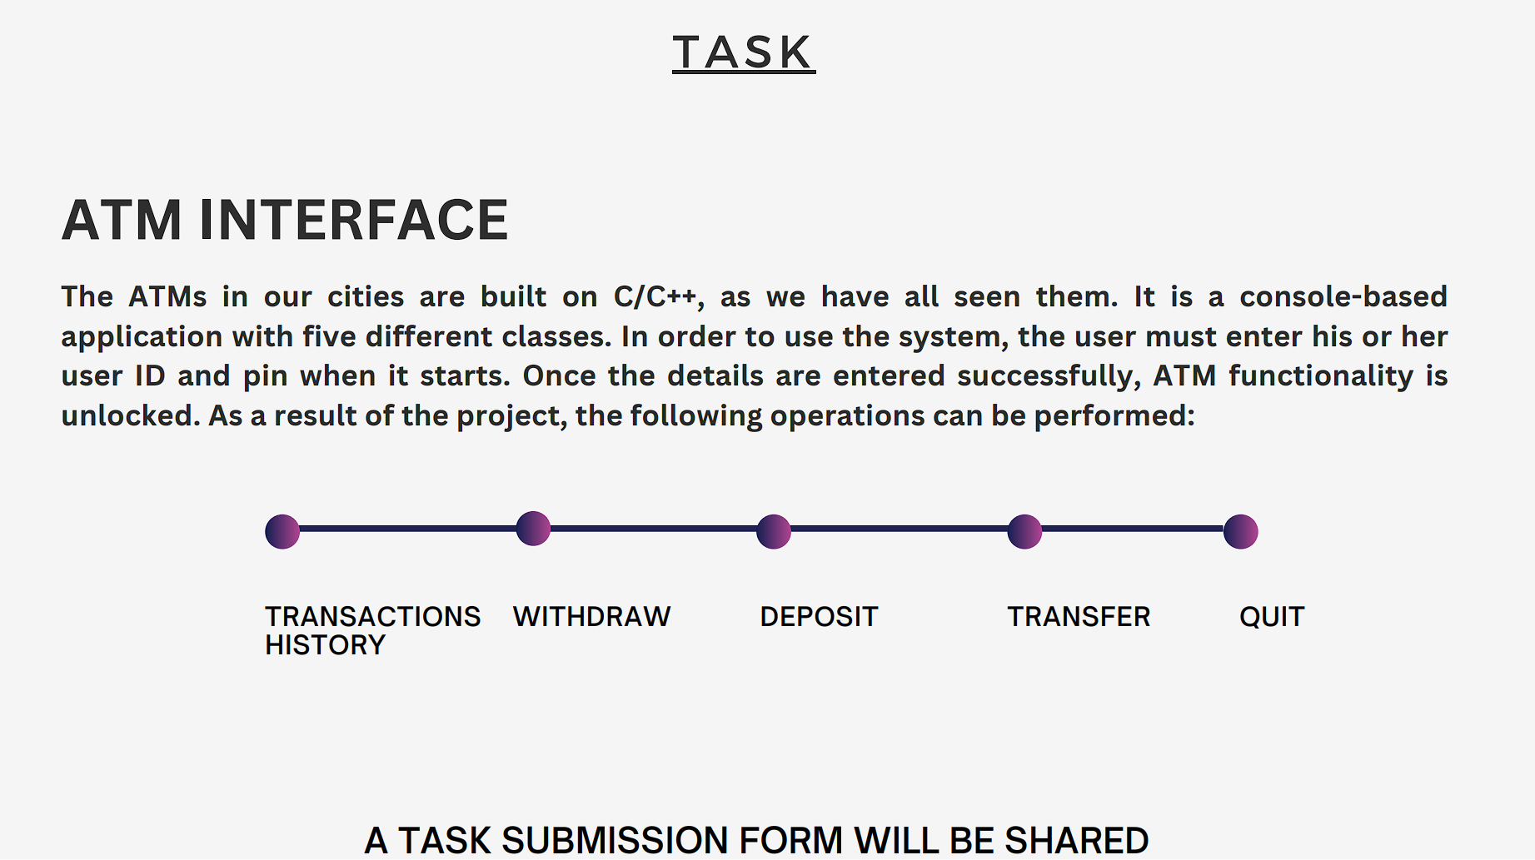
Task:
To Create an ATM INTERFACE using c/c++
It must contain following functions:
Transactions History
Withdrawal Statement
Deposite Statement
Transfered Money
Quit

Slide 4
Introduction:
An ATM (Automated Teller Machine) interface is a critical component of modern banking that allows customers to perform various financial transactions quickly and conveniently.
It serves as a bridge between customers and their bank accounts, providing access to a wide range of banking services without the need for human assistance.
The ATM interface is designed to simplify and streamline banking operations for account holders, offering them a self-service channel that is available 24/7.
This interface has become an integral part of our daily lives, revolutionizing the way we manage our finances.

Slide 5
Problem Statement:
Design and implement an ATM (Automated Teller Machine) interface using the C programming language.
The ATM interface should allow users to perform standard banking operations, such as checking account balance, depositing funds, withdrawing funds, and transferring funds between accounts.
The program should provide a user-friendly interface with clear instructions and error handling for various scenarios.

Slide 6
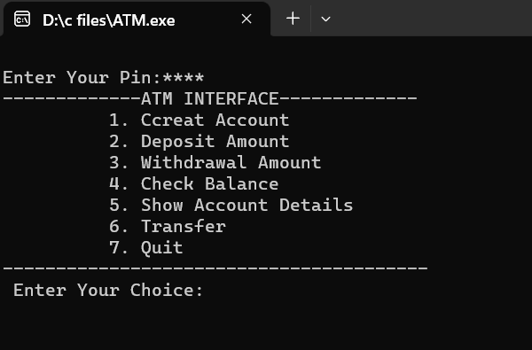
ATM INTERFACE:

Slide 7
Challenges and Learning Opportunities:
Function to perform a money transfer:
Limiting number of invald passwords:
Creating many accounts:
We create two account instances and prompt the user for the transfer amount.
For safety purpose, we must provide limited numbers of trials and out the user from the system for providing wrong passward three times in a row.
In this program we can create ‘n’ numbers of accounts but can not maintain records because database feature are not added yet.

Slide 8
Skills Acquired:
Creating an ATM (Automated Teller Machine) interface in C can be a valuable learning experience that include various programming and software development concepts.
Designing a user-friendly interface for interacting with users. This involves using text-based menus, input validation, and displaying information clearly.
Developing an ATM interface will require robust error-handling mechanisms to handle various scenarios, such as incorrect PINs, insufficient funds, or system errors.
ATM transactions often involve conditional logic, where different actions are taken based on user input and account conditions. This strengthens your understanding of conditional statements.

Slide 9
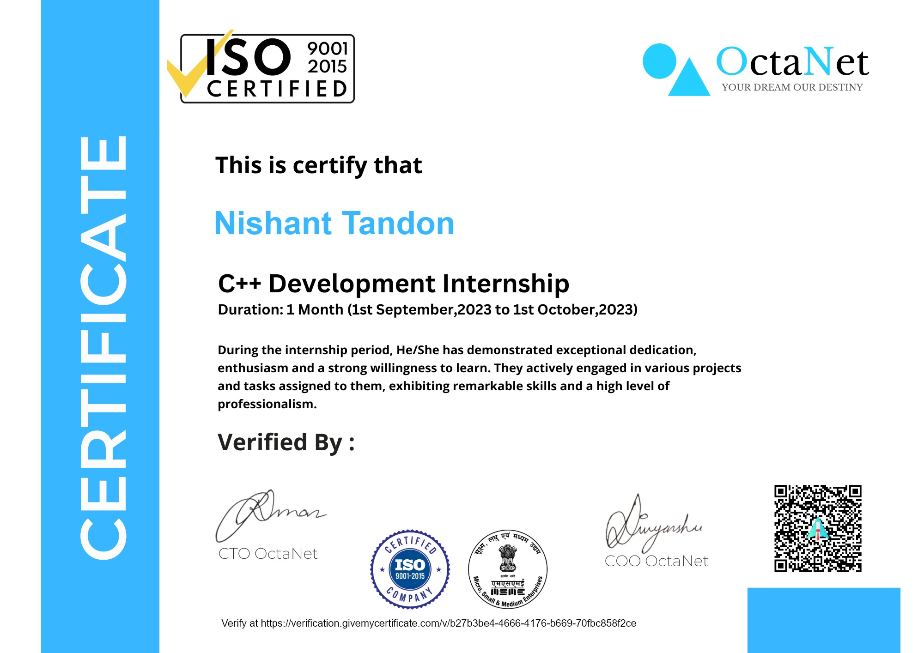
Achievement:

Slide 10
Conclusion:
An automated teller machine (ATM) is an electronic telecommunications system that allows customers of banking firms to conduct financial transactions. We can create an ATM program in Java to display ATM transactions, and the user can withdraw money, deposit money, check the balance, and exit from the ATM.
Hence we manage to create a smooth and user-friendly experience, ensuring that users can easily perform their banking operations without confusion.
The development of an ATM interface in C is a complex and educational endeavor that encompasses a wide range of programming and software development skills.

Slide 11


